Slide 1
if, if-else, switch, break, continue, jump

Slide 2
Decision Making in Java (if, if-else, switch, break, continue, jump)
A programming language uses control statements to control the flow of execution of a program based on certain conditions
Programs should be able to make logical (true/false) decisions based on the condition provided.
So controlling the execution of statements based on certain condition or decision is called decision making and branching.

Slide 3
Types of Decision Making Statements in Java
There are the 6 ways of exercising decision making in Java:
1. if 2. if-else 3. nested-if 4. if-else-if 5. switch-case 6. jump-break, continue, return

Slide 4
Syntax:
if(Boolean_expression)
statement1;
statement2; // Statements will execute if the Boolean expression is true Statement-X;

Slide 5
Write a programme to compare two given numbers and display which of them greater or whether they are equal.
public class NumberComparison
{
public static void main(String[] args)
{
int number1 = 5; // Replace with your desired number
int number2 = 8; // Replace with your desired number
if (number1 > number2) {
System.out.println(number1 + " is greater than " + number2);
}
if (number1 < number2) {
System.out.println(number2 + " is greater than " + number1);
}
if (number1 == number2)
System.out.println(number1 + " and " + number2 + " are equal");
}
}
}

Slide 6
If-else
Syntax:
if(Boolean_expression)
{ // Executes when the Boolean expression is true }else { // Executes when the Boolean expression is false } Statement-X;

Slide 7
import java.util.Scanner;
public class EvenOdd
{
public static void main(String[] args)
{
Scanner sc = new Scanner(System.in);
System.out.print("Enter an integer: ");
int number = sc.nextInt();
if (isEven(number) = = true)
{
System.out.println(number + " is an even number.");
}
else
{
System.out.println(number + " is an odd number.");
}
}
public static boolean isEven(int number)
{
if (number % 2 == 0)
return true;
else
return false;
}
}

Slide 8
If-else-if
Syntax:
if(Boolean_expression 1) { // Executes when the Boolean expression 1 is true }
else if(Boolean_expression 2) { // Executes when the Boolean expression 2 is true }
else if(Boolean_expression 3) { // Executes when the Boolean expression 3 is true }
else { // Executes when the none of the above condition is true. } Statement-X;

Slide 9
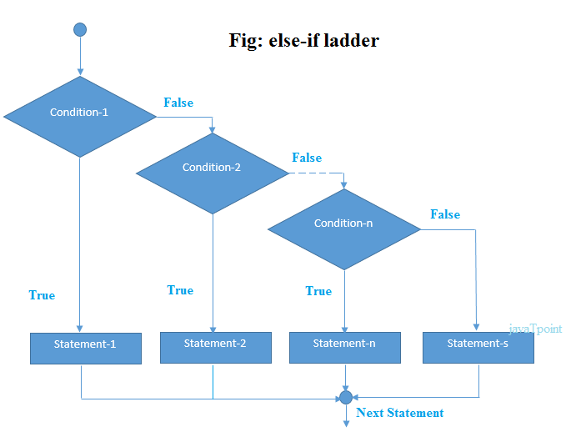

Slide 10
Condition for leap year
A century year is a year ending with 00. A century year is a leap year only if it is divisible by 400.
A leap year (except a century year) can be identified if it is exactly divisible by 4.
A century year should be divisible by 4 and 100 both.
A non-century year should be divisible only by 4.

Slide 11
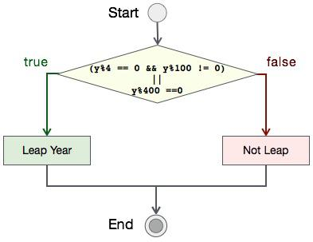

Slide 12
Nested if
As discussed earlier, nesting refers to within.
Nested if refers to if within an if statement.
There can be any number of if statements within another if statement.
The nested if statement comes under the category of the decision-making statements in Java.

Slide 13
if( test_condition1){
if( test_condition2){
if( test_condition3){
if( test_condition4){
//statements to execute
}
}
}
}

Slide 14
Nested if-else
if(condition1){
if(condition2){
//statements2.1
}
else{
//statements2.2
}
}
else{
//statements1
}

Slide 15
LeapYearExample BlueJ

Slide 16
import java.util.Scanner;
public class LeapYearProgram {
public static void main(String[] args) {
Scanner scanner = new Scanner(System.in);
System.out.print("Enter a year: ");
int year = scanner.nextInt();
if (year % 4 == 0) {
if (year % 100 == 0) {
if (year % 400 == 0) {
System.out.println(year + " is a leap year.");
} else {
System.out.println(year + " is not a leap year.");
}
} else {
System.out.println(year + " is a leap year.");
}
} else {
System.out.println(year + " is not a leap year.");
}
}
}

Slide 17
Write a program to input three numbers and check whether they are equal or not. If they are unequal numbers then display the greatest among them otherwise, display the message 'All the numbers are equal'.

Slide 18
import java.util.Scanner;
public class Largest
{
public static void main(String args[]) {
Scanner in = new Scanner(System.in);
System.out.print("Enter first number: ");
int a = in.nextInt();
System.out.print("Enter second number: ");
int b = in.nextInt();
System.out.print("Enter third number: ");
int c = in.nextInt();
if (a == b && b == c) {
System.out.println("All the numbers are equal");
}
else {
int g = a;
if (b > g)
g = b;
if (c > g)
g = c;
System.out.println("Greatest number: " + g);
}
}
}

Slide 19
Write a program to accept a number and check whether the number is divisible by 3 as well as 5.
Otherwise, decide:
(a) Is the number divisible by 3 and not by 5? (b) Is the number divisible by 5 and not by 3? (c) Is the number neither divisible by 3 nor by 5?
The program displays the message accordingly.

Slide 20
import java.util.Scanner;
public class Divisor
{
public static void main(String args[]) {
Scanner in = new Scanner(System.in);
System.out.print("Enter number: ");
int num = in.nextInt();
if (num % 3 == 0 && num % 5 == 0)
System.out.println("Divisible by 3 and 5");
else if (num % 3 == 0)
System.out.println("Divisible by 3 but not by 5");
else if (num % 5 == 0)
System.out.println("Divisible by 5 but not by 3");
else
System.out.println("Neither divisible by 3 nor by 5");
}
}

Slide 21
Write a program to input year and check whether it is:
(a) a Leap year
(b) a Century Leap year
(c) a Century year but not a Leap year

Slide 22
import java.util.Scanner;
public class LeapYear
{
public static void main(String args[]) {
Scanner in = new Scanner(System.in);
System.out.print("Enter the year to check: ");
int yr = in.nextInt();
if (yr % 4 == 0 && yr % 100 != 0)
System.out.println("It is a Leap Year");
else if (yr % 400 == 0)
System.out.println("It is a Century Leap Year");
else if (yr % 100 == 0)
System.out.println("It is a Century Year but not a Leap Year");
else
System.out.println("It is neither a Century Year nor a Leap Year");
}
}

Slide 23
Write a program to input three angles of a triangle and check whether a triangle is possible or not. If possible then check whether it is an acute-angled triangle, right-angled or an obtuse-angled triangle otherwise, display 'Triangle not possible'. Sample Input: Enter three angles: 40, 50, 90 Sample Output: Right=angled Triangle
TriangleAngleChk- BlueJ Program

Slide 24
import java.util.Scanner;
public class TriangleAngleChk
{
public static void main(String args[]) {
Scanner in = new Scanner(System.in);
System.out.print("Enter first angle: ");
int a1 = in.nextInt();
System.out.print("Enter second angle: ");
int a2 = in.nextInt();
System.out.print("Enter third angle: ");
int a3 = in.nextInt();
int angleSum = a1 + a2 + a3;
if (angleSum == 180 && a1 > 0 && a2 > 0 && a3 > 0) {
if (a1 < 90 && a2 < 90 && a3 < 90) {
System.out.println("Acute-angled Triangle");
}
else if (a1 == 90 || a2 == 90 || a3 == 90) {
System.out.println("Right-angled Triangle");
}
else {
System.out.println("Obtuse-angled Triangle");
}
}
else {
System.out.println("Triangle not possible");
}
}
}

Slide 25
Write a program to input three unequal numbers. Display the greatest and the smallest number.

Slide 26
import java.util.Scanner;
public class KboatMinMaxNumbers
{
public static void main(String args[]) {
Scanner in = new Scanner(System.in);
System.out.println("Enter 3 unequal numbers");
System.out.print("Enter first number: ");
int a = in.nextInt();
System.out.print("Enter second number: ");
int b = in.nextInt();
System.out.print("Enter third number: ");
int c = in.nextInt();
int min = a, max = a;
min = b < min ? b : min;
min = c < min ? c : min;
max = b > max ? b : max;
max = c > max ? c : max;
System.out.println("Greatest Number: " + max);
System.out.println("Smallest Number: " + min);
}
}

Slide 27
A Pre-Paid taxi charges from the passenger as per the tariff given below:
Distance Rate
Up to 5 km ₹ 100
For the next 10 km ₹ 10/km
For the next 10 km ₹ 8/km
More than 25 km ₹ 5/km
Write a program to input the distance covered and calculate the amount paid by the passenger. The program displays the printed bill with the details given below:
Taxi No. :
Distance covered :
Amount :
BlueJProgram-PrePaidTaxi

Slide 28
import java.util.Scanner;
public class PrePaidTaxi
{ public static void main(String args[]) {
Scanner in = new Scanner(System.in);
System.out.print("Enter Taxi Number: ");
String taxiNo = in.nextLine();
System.out.print("Enter distance travelled: ");
int dist = in.nextInt();
int fare = 0;
if (dist <= 5)
fare = 100;
else if (dist <= 15)
fare = 100 + (dist - 5) * 10;
else if (dist <= 25)
fare = 100 + 100 + (dist - 15) * 8;
else
fare = 100 + 100 + 80 + (dist - 25) * 5;
System.out.println("Taxi No: " + taxiNo);
System.out.println("Distance covered: " + dist);
System.out.println("Amount: " + fare);
}
}

Slide 29
A cloth showroom has announced festival discounts and the gifts on the purchase of items, based on the total cost as given below:
Total Cost Discount Gift
Up to ₹ 2,000 5% Calculator
₹ 2,001 to ₹ 5,000 10% School Bag
₹ 5,001 to ₹ 10,000 15% Wall Clock
Above ₹ 10,000 20% Wrist Watch
Write a program to input the total cost. Compute and display the amount to be paid by the customer along with the gift.

Slide 30
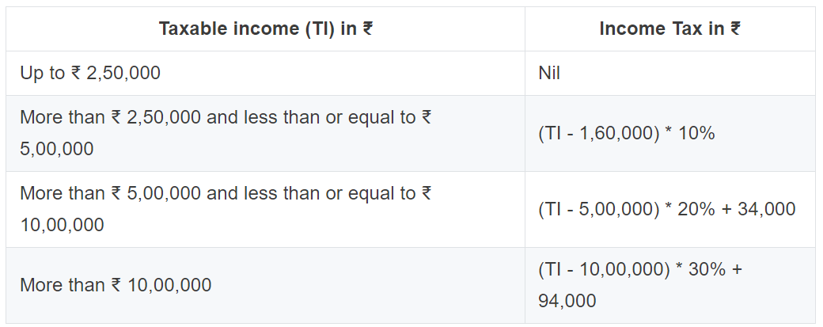
Given below is a hypothetical table showing rate of income tax for an India citizen, who is below or up to 60 years.
Write a program to input the name, age and taxable income of a person. If the age is more than 60 years then display the message "Wrong Category". If the age is less than or equal to 60 years then compute and display the income tax payable along with the name of tax payer, as per the table given above.

Slide 31
Using a switch case statement, write a menu driven program to convert a given temperature from Fahrenheit to Celsius and vice-versa. For an incorrect choice, an appropriate message should be displayed.
Hint: c = 5/9*(f-32) and f=1.8*c+32
Temperature – BlueJ Program

Slide 32
Java Switch Statement
The Java switch statement executes one statement from multiple conditions.
It is like if-else-if ladder statement.
The switch statement works with byte, short, int, long, enum types,
In other words, the switch statement tests the equality of a variable against multiple values.

Slide 33
Points to Remember
There can be one or N number of case values for a switch expression.
The case value must be of switch expression type only. The case value must be literal or constant. It doesn't allow variables.
The case values must be unique. In case of duplicate value, it renders compile-time error.
The Java switch expression must be of byte, short, int, long and string.

Slide 34
Each case statement can have a break statement which is optional. When control reaches to the break statement, it jumps the control after the switch expression.
If a break statement is not found, it executes the next case.
The case value can have a default label which is optional.

Slide 35
Syntax:
switch(expression)
{
case value1:
//code to be executed;
break; //optional
case value2:
//code to be executed;
break; //optional
......
default:
code to be executed if all cases are not matched;
}

Slide 36
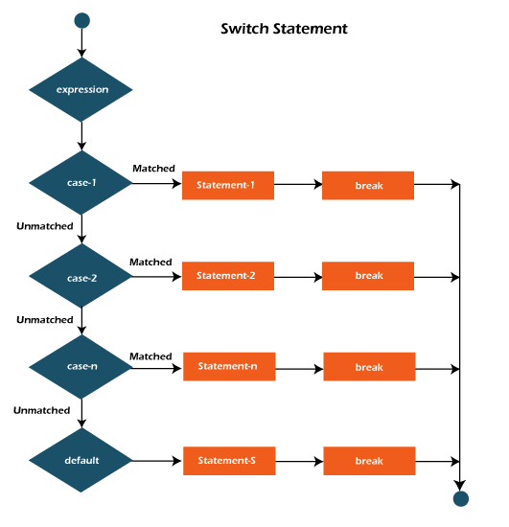

Slide 37
Switch case Example
int day = 4;
switch (day) {
case 1:
System.out.println("Monday");
break;
case 2:
System.out.println("Tuesday");
break;
case 3:
System.out.println("Wednesday");
break;
case 4:
System.out.println("Thursday");
break;
case 5:
System.out.println("Friday");
break;
case 6:
System.out.println("Saturday");
break;
case 7:
System.out.println("Sunday");
break;
}

Slide 38
public class SwitchExample {
public static void main(String[] args) {
//Declaring a variable for switch expression
int number=20;
//Switch expression
switch(number){
//Case statements
case 10: System.out.println("10");
break;
case 20: System.out.println("20");
break;
case 30: System.out.println("30");
break;
//Default case statement
default:System.out.println("Not in 10, 20 or 30");
}
}
}

Slide 39
// In a switch, break statements are optional.
class MissingBreak {
public static void main(String args[]) {
for(int i=0; i<12; i++)
switch(i) {
case 0:
case 1:
case 2:
case 3:
case 4:
System.out.println("i is less than 5");
break;
case 5:
case 6:
case 7:
case 8:
case 9:
System.out.println("i is less than 10");
System.out.println("i is less than 10");
break;
default:
System.out.println("i is 10 or more");
}
}
}

Slide 40
// Use a string to control a switch statement.
class StringSwitch {
public static void main(String args[]) {
String str = "two";
switch(str) {
case "one":
System.out.println("one");
break;
case "two":
System.out.println("two");
break;
case "three":
System.out.println("three");
break;
default:
System.out.println("no match");
break;
}
}
}

Slide 41
The Simple Interest (SI) and Compound Interest (CI) of a sum (P) for a given time (T) and rate (R) can be calculated as:
SI = (p * r * t) / 100 (b) CI = P * ((1 + (R / 100))^{T} - 1)
Write a program to input sum, rate, time and type of Interest ('S' for Simple Interest and 'C' for Compound Interest). Calculate and display the sum and the interest earned.

Slide 42
A Mega Shop has different floors which display varieties of dresses as mentioned below:
Ground floor : Kids Wear
First floor : Ladies Wear
Second floor : Designer Sarees
Third Floor : Men's Wear
The user enters floor number and gets the information regarding different items of the Mega shop. After shopping, the customer pays the amount at the billing counter and the shopkeeper prints the bill in the given format:
Name of the Shop: City Mart Total Amount: Visit Again!!
Write a program to perform the above task as per the user's choice.
Megashop BlueJ Program

Slide 43
The volume of solids, viz. cuboid, cylinder and cone can be calculated by the formula:
Volume of a cuboid (v = l*b*h)
Volume of a cylinder (v = π*r²*h)
Volume of a cone (v = (1/3)*π*r²*h)
Using a switch case statement, write a program to find the volume of different solids by taking suitable variables and data types.

Slide 44
Write a Java program that requires the user to enter a single character from the alphabet. Print Vowel or Consonant, depending on user input. If the user input is not a letter (between a and z or A and Z), or is a string of length > 1, print an error message.

